Slide 1
Optimize the power consumption
of Zone 1 based on various environmental and
meteorological factors in
Wellington, New-Zealand
Presented by
Manisha Kumari

Slide 2
Objective
The objective is to develop a machine learning model that can predict the power consumption of Zone 1 in Wellington based on environmental and meteorological data.
Goal: Efficient energy management & optimization

Slide 3
About the Data Set
Our Data-Set has almost 52000 records and these columns:
Temperature (Object ,should be numeric)
Humidity (Object, Should be Numeric)
Wind-Speed
General Diffuse Flows
Diffuse Flows
Air Quality Index (PM)
Cloudiness
Target :Power Consumption in A Zone.

Slide 4
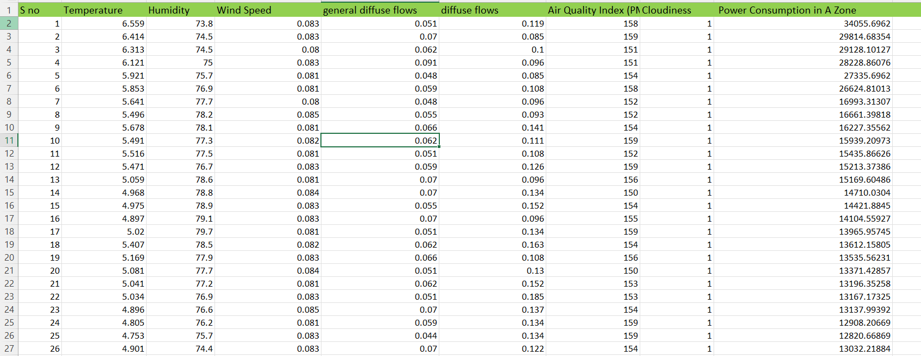

Slide 5
Methodology
1️⃣ Data Cleaning (missing values, data type conversion)
2️⃣ Feature Selection
3️⃣ Model Training using Random Forest Regressor
4️⃣ Model Evaluation (R² score)
5️⃣ Visualization of results

Slide 6
Project steps in simple terms:
Read the data : (CSV / Excel / cleaned data)
Clean data (remove NaNs, fix column names, ensure numbers are really numbers)
Split data:
Input (X): temperature, humidity, wind speed, etc.
Output (y): power consumption
Train model: RandomForestRegressor learns the relationship
Evaluate model: how good are the predictions?
Analyze feature importance: see what drives power use
Visualize: plot real vs predicted, feature importance, heatmaps

Slide 7
Model Selection
Linear Regression(BaseLine)
Decision Tree Regressor
Random Forest Regressor

Slide 8
Why we choose Random Forest Regressor
What it is: An ensemble of many decision trees → each trained on different parts of the data.
Why better:
Capture complex, Non-Linear Patterns
Reduce overfitting by averaging multiple tress→ Makes the model more robust.
Generally achieves Higher Accuracy on real world Data.
We use RandomForestRegressor because:
Our Target variable(Power Consumption in A Zone) is a continuous number
Random Forest can learn complex relationship between weather(temperature, humidity,cloudiness etc) and Power Consumptions
It also tells us which factors are most important for prediction.

Slide 9
Model Training and Testing
Split data into train and test (80% Train , 20% Test)
Train the Model
Used Random Forest Regressor with training and testing split.
- Train size: 80%
- Test size: 20%
Model achieved R² score ≈ 0.64.
Tools: Python, Pandas, Scikit-learn, matplotlib

Slide 10
Evaluation Metrics
Metrics:
Mean Absolute Error(MAE): Average of Absolute difference between Predictions and Actual values
Mean Squared Error(MSE): Avergae of Squared differences between actual values and predicted values
R² Score: It is known as Coefficient of Determination, is statistical measure to evaluate how well your regression model explains the variability of the target variable. Shows How much variance in the target variable (Closer to 1 is better)

Slide 11
Visualization & Insights
Graphs/Charts:
Histogram of Temperature and Humidity
Scatter Plot: Temperature vs Power Consumptions
Correlation Heatmap

Slide 12
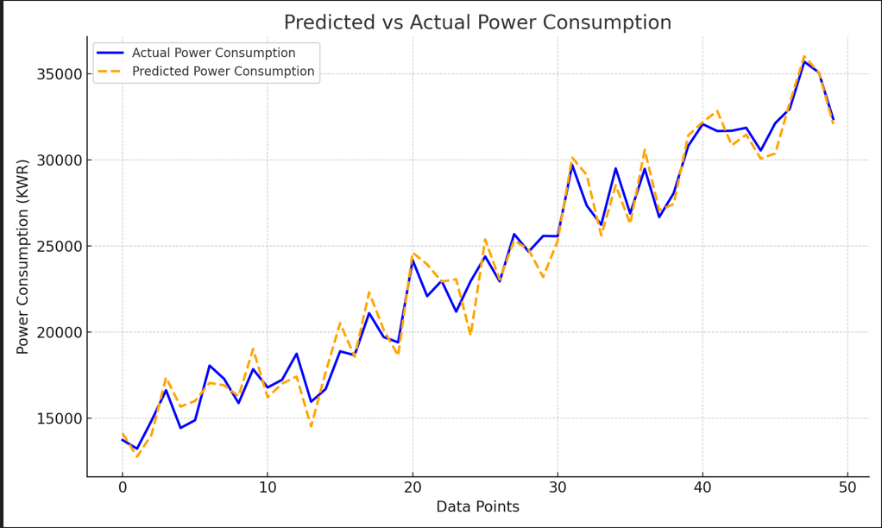
Results and Graphs

Slide 13
Predicted vs Actual Values (Line Plot)
What to show:
X-axis: Data points (could be time, serial number, etc.)
Y-axis: Power Consumption (KWR)
Two lines:
Actual values (e.g., blue)
Predicted values (e.g., orange)
What it shows:
How closely your model’s predictions match the real values.
explanation: “This plot shows that our model’s predictions are very close to the actual power consumption values, which means the model is performing well.”

Slide 14
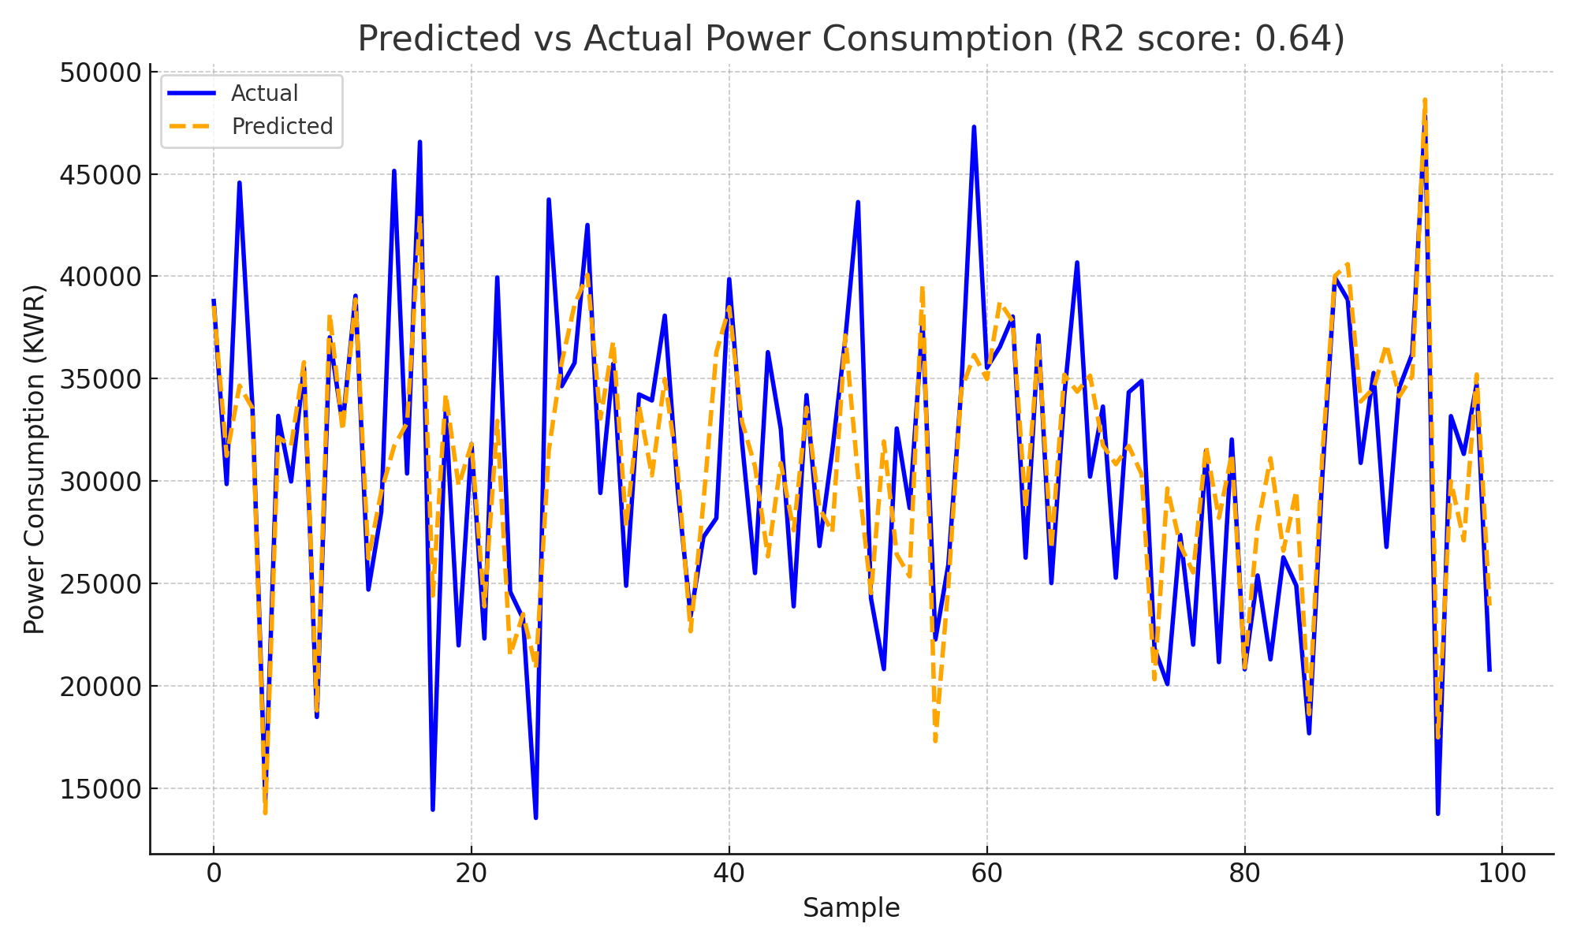

Slide 15
Feature Importance (Bar Chart)
What to show:
X-axis: Feature names (Temperature, Humidity, Air Quality Index, etc.)
Y-axis: Importance score (how much each feature affects prediction)
What it shows:
Which features are most influential in predicting power consumption.
explanation: “This graph shows that features like Temperature, Humidity and Air Quality Index have higher importance in predicting power consumption.”

Slide 16
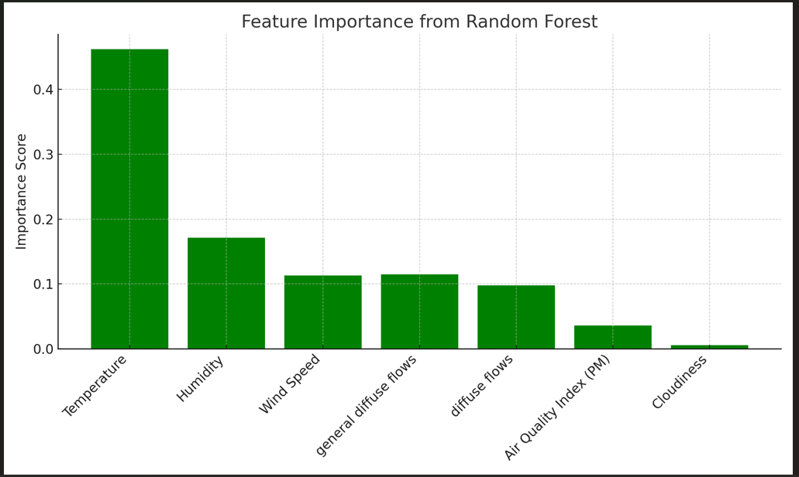

Slide 17
Result and Insights
Model predictions are close to actual power consumption.
Important factors: Temperature, Humidity, Air Quality Index.

Slide 18
Conclusion
✅ Developed a machine learning model to predict Zone 1 power consumption.
✅ Achieved good accuracy (R² ≈ 0.64).
✅ Identified key influencing features.

Slide 19
Thank You

